Slide 1
Seminar 5
Maksym Shevchenko, AI-1

Slide 2
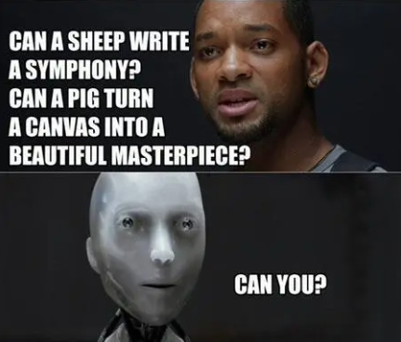
Moral challenge in the field of artificial intelligence
Biases
Control and the Morality of AI
Privacy
Power Balance
Ownership
Environmental Impact
Humanity
Notes:
Biases
We need data to train our artificial intelligence algorithms, and we need to do everything we can to eliminate bias in that data.
The ImageNet database, for example, has far more white faces than non-white faces. When we train our AI algorithms to recognize facial features using a database that doesn’t include the right balance of faces, the algorithm won’t work as well on non-white faces, creating a built-in bias that can have a huge impact.
Control and the Morality of AI
As we use more and more artificial intelligence, we are asking machines to make increasingly important decisions.
For example, right now, there is an international convention that dictates the use of autonomous drones. If you have a drone that could potentially fire a rocket and kill someone, there needs to be a human in the decision-making process before the missile gets deployed. So far, we have gotten around some of the critical control problems of AI with a patchwork of rules and regulations like this.
Privacy
Privacy (and consent) for using data has long been an ethical dilemma of AI. We need data to train AIs, but where does this data come from, and how do we use it? Sometimes we make the assumption that all the data is coming from adults with full mental capabilities that can make choices for themselves about the use of their data, but we don’t always have this.
For example, Barbie now has an AI-enabled doll that children can speak to. What does this mean in terms of ethics? There is an algorithm that is collecting data from your child’s conversations with this toy. Where is this data going, and how is it being used?
Power Balance
Huge companies like Amazon, Facebook, Google, are using artificial intelligence to squash their competitors and become virtually unstoppable in the marketplace. Countries like China also have ambitious AI strategies that are supported by the government. President Putin of Russia has said, “Whoever wins the race in AI will probably become the ruler of the world.”
How do we make sure the monopolies we’re generating are distributing wealth equally and that we don’t have a few countries that race ahead of the rest of the world? Balancing that power is a serious challenge in the world of AI.
Ownership
Who is responsible for some of the things that AIs are creating?
We can now use artificial intelligence to create text, bots, or even deepfake videos that can be misleading. Who owns that material, and what do we do with this kind of fake news if it spreads across the internet?
We also have AIs that can create art and music. When an AI writes a new piece of music, who owns it? Who has the intellectual property rights for it, and should potentially get paid for it?
Environmental Impact
Sometimes we don’t think about the environmental impact of AI. We assume that we are using data on a cloud computer to train an algorithm, and then that data is used to run recommendation engines on our website. However, the computer centers that run our cloud infrastructure are power-hungry.
Training in AI, for example, can create 17 times more carbon emissions than the average American does in about a year.
Humanity
My final challenge is “How does AI make us feel as humans?” Artificial intelligence has now gotten so fast, powerful, and efficient that it can leave humans feeling inferior. This issue may challenge us to think about what it actually means to be human.
AI will also continue to automate more of our jobs. What will our contribution be, as human beings? I don’t think artificial intelligence will ever replace all our jobs, but AI will augment them. We need to get better at working alongside smart machines so we can manage the transition with dignity and respect for people and technology.

Slide 3
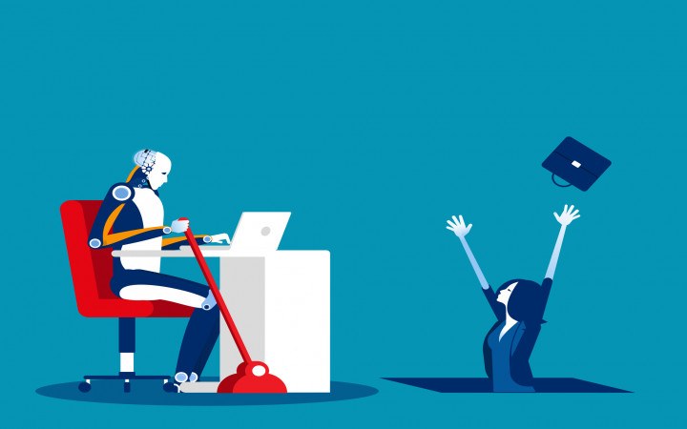
Artificial intelligence and the problem of redundant people: ethical dimension
Notes:
Issues around employment and AI are important, and there is the concern that AI may make many people’s professions redundant in the future. In agriculture, this is very concerning for many. However, the importance of employment was not fully captured within the AI ethics guidelines, as there was no explicit reference to it within the overarching principles or the subsequent coding. This may be more to do with the fact that issues of unemployment and job loss are not explicitly ethical or social issues, but are a myriad of economic, legal, and societal issues, as well. However, the impact of AI on employment certainly raises explicit social and ethical issues around justice, fairness, power, and equality, and should be given adequate treatment in agricultural AI and AI ethics.
I believe that AI will not be able to replace people in many professions. In addition, new professions will be created to replace the old ones replaced by AI. For example, the creation and maintenance of automated systems.

Slide 4
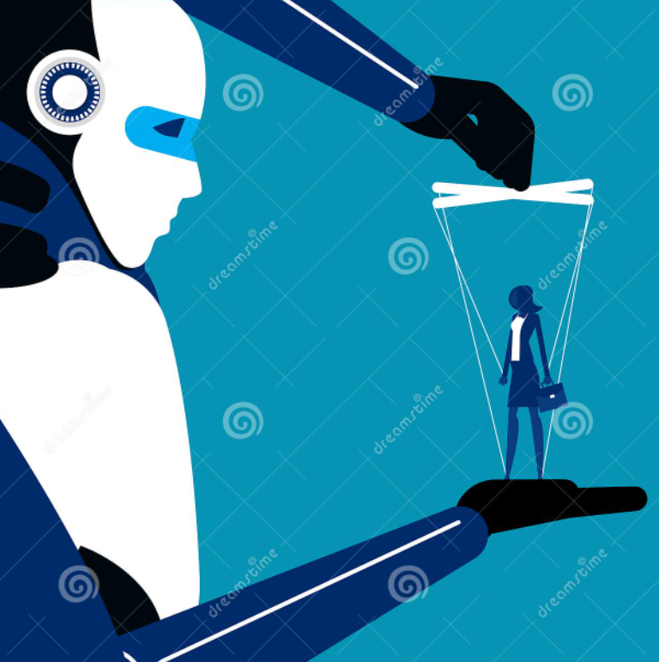
While growing together with gadgets, what measure does a human still remain a human being to?
TECHNOLOGY AFFECT
Critical Thinking
Attention & Imagination
Privacy & Safety
Notes:
We use gadgets to make our lives easier. What we translate into the technology of performing complex tasks does not deprive us of the right to be called a person. Even if all the work is done, and we just have to live to our heart's content, we will still be human.
However, the widespread use of gadgets has its drawbacks, especially in terms of people's mental development.
Critical Thinking
Not surprisingly, studies have shown that the increase of technology has led to a decrease in daily reading. In addition, it’s been argued that because many blocks of text you encounter on digital devices are written in 140 characters or less, children are not challenged to think critically, or to expand on their thoughts.
Attention & Imagination
Attention span development is affected by environmental factors. With the various forms of technology available, children are often more distracted and less likely to focus on something else when it is present.
Privacy & Safety
As advances in technology lead to increasing levels of connectedness, we must consider the effects that social media and the internet can have on our child’s mental outlook, as well as their privacy and safety. It is important to know what activities your children are exploring online as well as cultivate an open relationship where your child feels comfortable discussing any concerning behavior they come across online.
Children in these settings can often be exposed to various degrees of bullying, which can have lasting impacts on a child’s social and emotional development as well as their self-esteem.

Slide 5
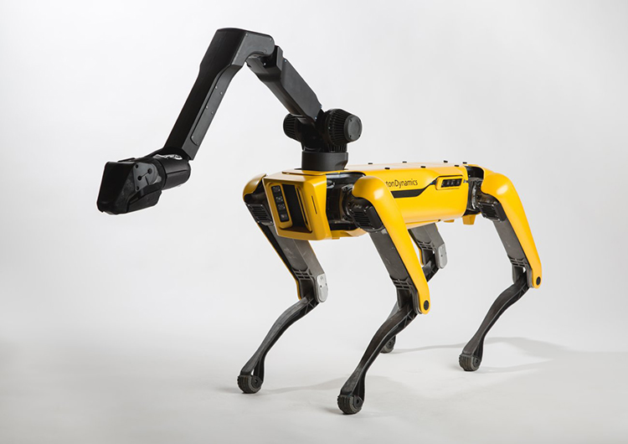
What are people ready to give up the artificial intelligence?
Manufacturing and
pharmaceutical work
Doctors
Soldiers
Taxi and bus drivers
Any other difficult or
dangerous work
Notes:
Manufacturing and pharmaceutical work
This sector is probably the most extensive area where people are scared that AI will take over jobs. When the production process for most commodities produced today has been mechanized, the operational aspect can also be handled by AI.
Even in pharmaceutical labs, robots can work together with scientists providing a much safer environment. Scientists will no longer be putting their lives less at risk.
Doctors
We are already witnessing robot-surgeons perform critical operations worldwide, and it’s only a matter of time before they completely replace us. Robotic doctors will make more accurate and effective treatments for the patients compared to their human counterparts. There is also less chance of infection due to more sterile measures and no room for human error.
Soldiers
Military professionals are sure that future battlefields will consist of robots that can follow orders without constant supervision. Robots are significantly being used in military operations for various tasks such as surveillance, intelligence, and many more.
Taxi and bus drivers
There is a 98% chance that this sector will be completely automated. Self-driving cars are already here, and it won’t be long before fully autonomous vehicles take over us.

Slide 6

Possibilities to regulate ethically the artificial intelligence: do they exist? what are they?
Notes:
Over the last few years, the world has deliberated and developed numerous ethical principles and frameworks. It is the general opinion that the time has arrived to move from principles and to operationalize on the ethical practice of AI. It is now recognized that principles and standards can play a universal harmonizing role for the development of AI-related legal norms across the globe. However, how do we translate and embrace these articulated values, principles and actions to guide Nation States around the world to formulate their regulatory systems, policies or other legal instruments regarding AI? Our regulatory systems have attempted to keep abreast of new technologies by recalibrating and adapting our regulatory frameworks to provide for new opportunities and risks, to confer rights and duties, safety and liability frameworks, and to ensure legal certainty for businesses. These past adaptations have been reactive and sometimes piecemeal , often with artificial delineation on rights and responsibilities and with un-intended flow-on consequences. Previously, technologies have been deployed more like tools, but as autonomy and self-learning capabilities increase, robots and intelligent AI systems will feel less and less like machines and tools. There is now a significant difference, because machine learning AI systems have the ability 'to learn', adapt their performances and 'make decisions' from data and 'life experiences'. This paper presented at the International Joint Conference on Artificial Intelligence-Pacific Rim International Conference on Artificial Intelligence in 2021 provides brief insights on some selected topical developments in ethical principles and frameworks, our regulatory systems and the current debates on some of the risks and challenges from the use and actions of AI, autonomous and intelligent systems.

Slide 7
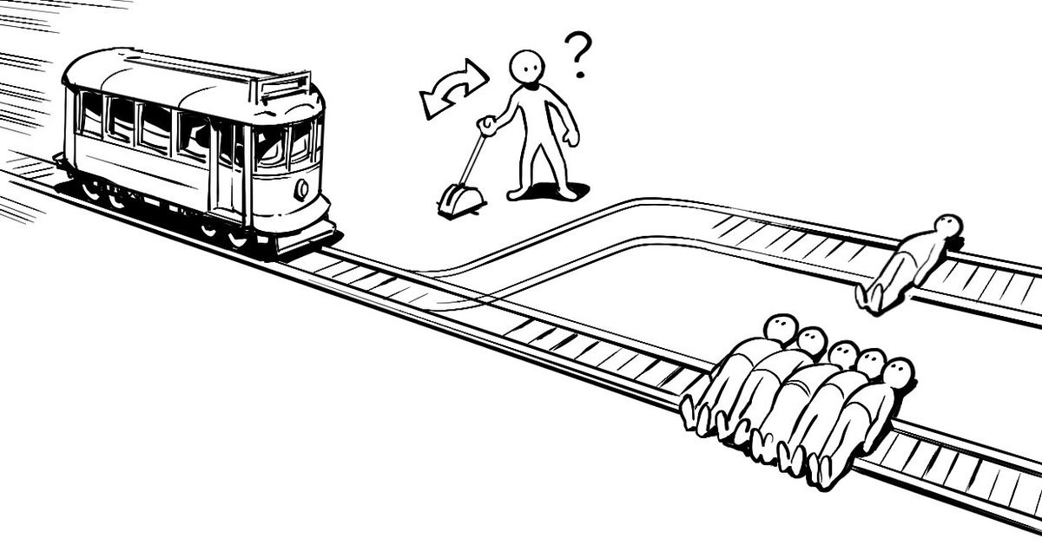
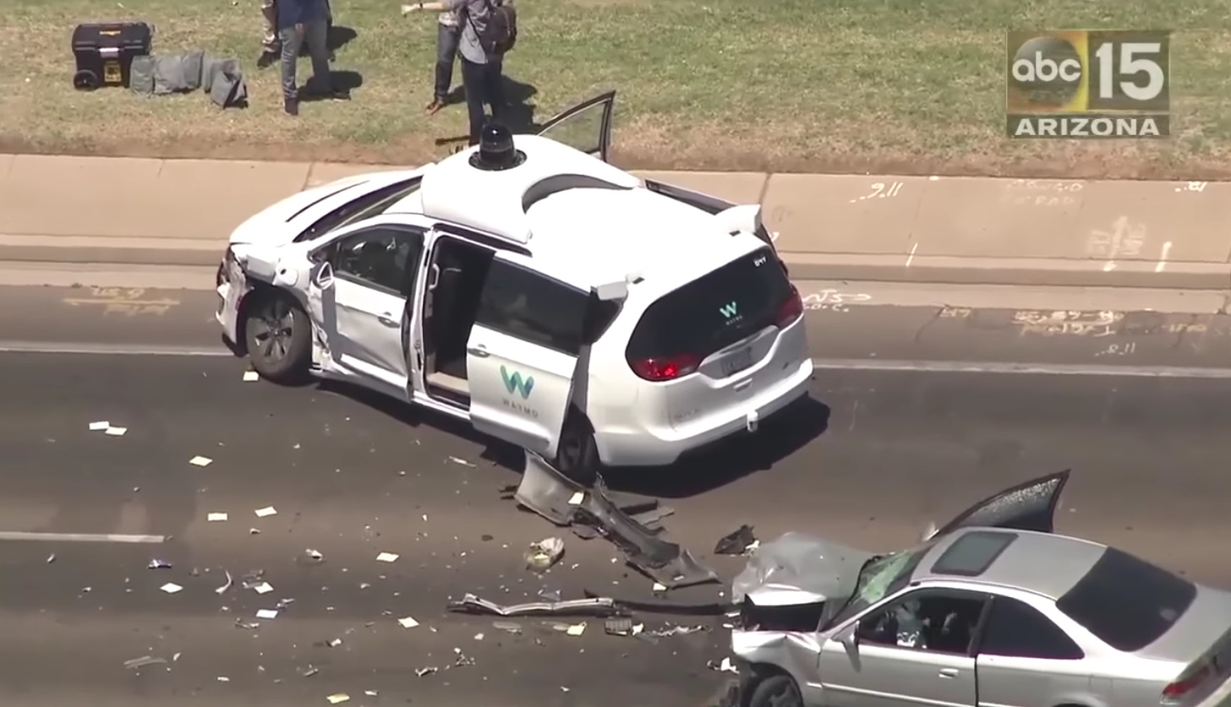
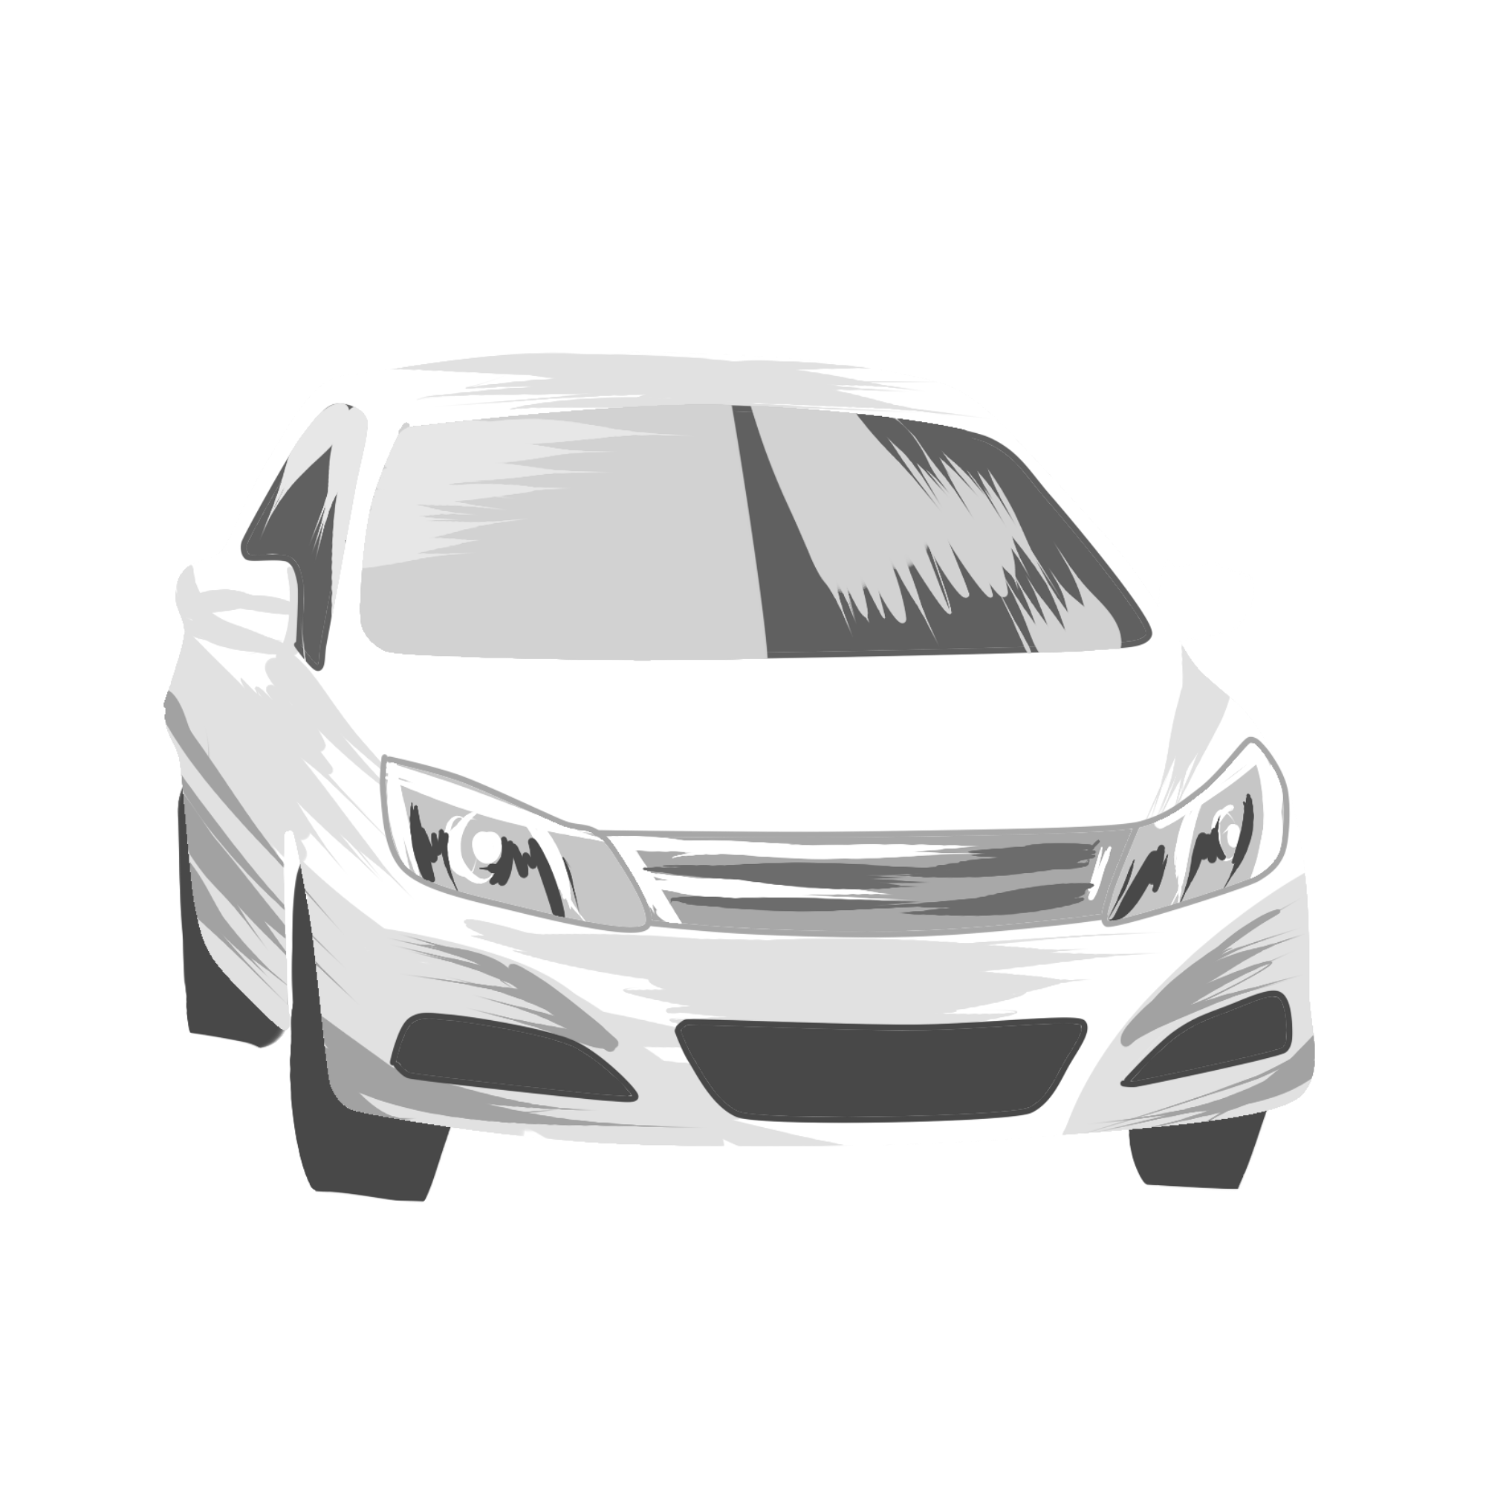

What ethical problems can you find in self-driving car prospects?
Notes:
How should the car behave in critical situations when it is impossible to avoid damage?
Let's imagine that a child suddenly ran out in front of the car and it is not possible to stop the car, but it is possible to adjust the trajectory. In this situation, the AI ​​may turn right onto the sidewalk, damaging homes and possibly other pedestrians; turn left into the oncoming lane, possibly causing an accident with the oncoming car; or go straight after killing a child. There are countless possible options for the development of the situation, but, unlike humans, the computer is much more likely to process information and choose a balanced, algorithmically determined solution. It is impossible to determine which of these options is the best.To ensure that the actions of AI in such situations are not determined solely by the wishes of the developer, it is possible to introduce a special test by the driver before buying a car. Let the driver choose how to do AI in such situations. Then the AI ​​will not be able to put the driver's life above the lives of pedestrians if the driver does not want to.
Who should be responsible for the accident (AI or driver)?
There are 6 levels of car automation:
Level 0. No frills, just a messaging system (sounds, etc.) - for example, Ford Focus 2004.
Level 1. The cars of the first level of autonomy have adaptive cruise control (maintains a variable speed and provides a safe distance to the car moving in front), parking assistance system and lane departure warning system.
Level 2. Automation of the second level includes driver assistance systems in driving, vehicle speed, as well as lane assistance system. At the same time, the driver must constantly keep his hands on the steering wheel in order to take control of the car in case of unforeseen circumstances (for example, cutting another car).
Level 3. At the third level, the line between existing technologies and technologies that we used to consider science fiction is blurred. It is assumed that the car does not require constant human attention - the driver may not hold the wheel constantly. However, in the third level, the autopilot operates only in ideal road conditions, and the manufacturers expect that a person will be able to intervene in the situation at any time, for example, if there is a risk of an accident.
Level 4. The car of the fourth level of autonomy can reach the destination independently, but under ideal conditions. If it starts to rain or snow, the driver will have to take control of the car. The fourth differs from the fifth level of autonomy in that cars need 3D terrain maps to compare it while driving. If the terrain is not on the map, the autopilot will switch to third level mode or turn off.
Level 5. If the zero level of autonomy is the car you drive, the fifth level is the car that does not need a driver. Level 5 cars already exist, but they do not carry people, but goods.
According to these levels, you can choose the culprit depending on the conditions of use of the car. If the AI ​​had to work in these conditions - the fault of the car developer, if not - the fault of the driver. However, it is difficult to determine these conditions and prove the guilt or innocence of the driver. However, the question remains whether the driver should be punished if he could have prevented the accident, but left control of the AI, because he had to drive the car himself in that situation.

